Slide 1
Schoolhouse Rock!…it’s time for an intervention
Overview of the Pennsylvania Legislative Process and Building Relationships
Sarah Copley, Senior Associate
Greenlee Partners, LLC

Slide 2
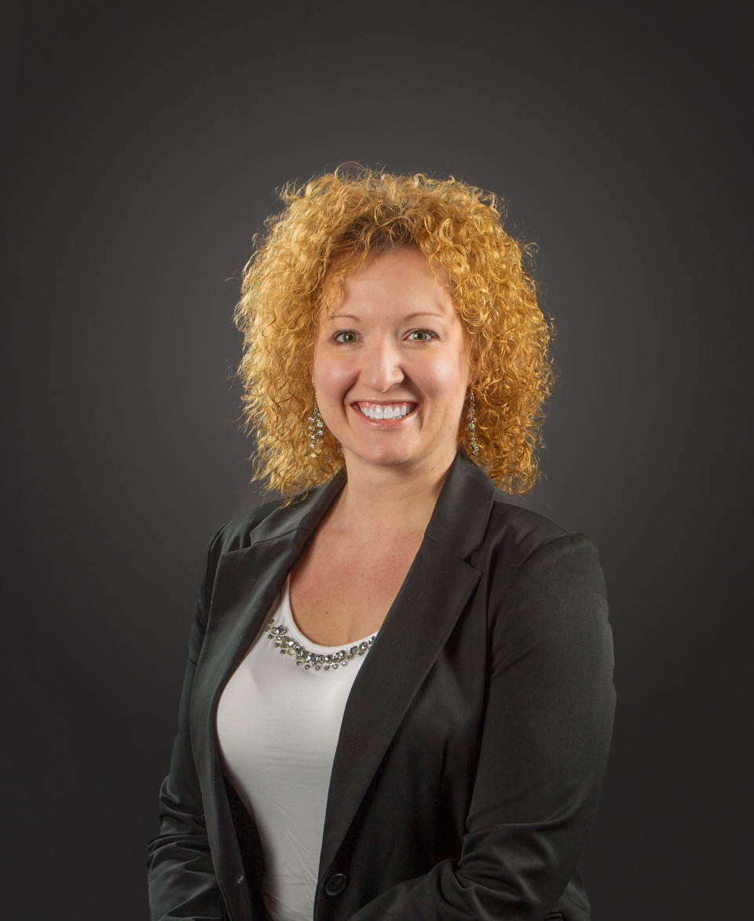
Hi there!
I am Sarah Copley
I am here because I love to give presentations…also Leeann made me…
More importantly, I love transportation issues!
You can reach me at sarah@greenleepartners.com or 717-798-1649

Slide 3
Wondering what’s gonna happen?
You’re not alone!
How about an agenda?
Legislative Process
How does a bill become a law?
Rules
Role of the Administration & Departments
Relationships
Not the dating kind…the professional kind
Relationship Building
Advocacy & Lobbying
Resources
www.palobbyingservices.state.pa.us
www.legis.state.pa.us

Slide 4
Legislative Process
1
Bill didn’t have it completely wrong…

Slide 5
I’m just a bill…yes, I’m only a bill…and I’m sitting here on Capitol Hill
Drafting & Filing a Bill
Co-sponsorship Memos
Bill Filing
Referral to Standing Committee
Bill Consideration
Committee Meeting Consideration
First Consideration
Second Consideration & Amendment Process
Appropriations Committee
Third Consideration & Final Passage

Slide 6
What Bill didn’t tell you…
Committees
Hearings vs. Voting Meetings
Appropriations
Re-referrals
Rules
Constitution
Rules of the Senate
Rules of the House
Leadership
Calendar
Committee Influence
Caucus

Slide 7
And if Bill is one of the lucky ones…
He’ll wait in line with all the other bills for the Governor to Sign or Veto

Slide 8
Role of the Administration
Governor
Policy Direction
Role of Staff
Departments & Agencies
Oversight
Implementation
Information
Regulatory Impact

Slide 9
Relationships
2
Bill didn’t have to wait so long…

Slide 10
Making, Keeping and Growing Your Relationships
Evaluate
Take an inventory of legislative, administrative, and regulatory relationships as well as relationships with staff
Who do you know?
Measure
Honestly rate the strength of the relationships
Math doesn’t lie
Act
Start to build relationships in weak areas and work to strengthen existing ones
Visibility, the enemy of amnesia

Slide 11
A tree with strong roots laughs at storms…
(Proverb)

Slide 12
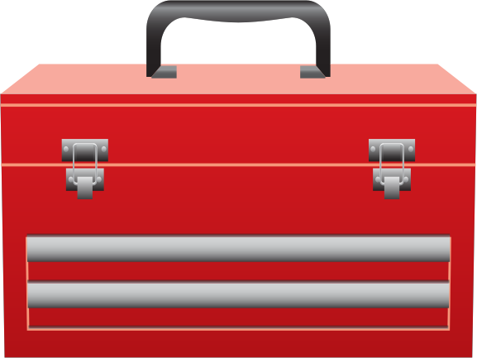
Advocacy
Understand what drives people and the process
Do more listening than talking

Slide 13
Issues Management
Credibility
Knowledge
Timing
Media
Coalitions

Slide 14
Lobbying Vs. Campaigning
Do
Understand the rules and etiquette
Expect the same of others
Don’t
Make common mistakes
Skirt the law
Track
Document and evaluate efforts
Campaigns
What CAN’T you say and when?
Benefits of engagement
Contributions
Individuals
PACs
Coalitions

Slide 15
Thanks!
ANY QUESTIONS?
You can find me at
sarah@greenleepartners.com

